Slide 1
Employee Data Analysis using Excel
STUDENT NAME: Somasundari.M
REGISTER NO: 312216305
DEPARTMENT: Bcom General
COLLEGE : Shri Shankarlal Sundarbai Shasun Jain College for women

Slide 2
PROJECT TITLE
Employee Salary Analysis using Excel

Slide 3


AGENDA
Problem Statement
Project Overview
End Users
Our Solution and Proposition
Dataset Description
Modelling Approach
Results and Discussion
Conclusion
3/21/2024 Annual Review

Slide 4

PROBLEM STATEMENT
A detailed understanding of the current salary distribution within the organization.
Identification of any salary disparities and inequities.
Actionable recommendations for salary adjustments and policy changes.
Enhanced ability to make data-driven decisions related to compensation and employee retention.

Slide 5

PROJECT OVERVIEW
Objective: Analyze salary distribution to identify disparities and improve compensation practices.
Data Fields:- Employee Info: ID, Name, Gender, Department, Start Date- Compensation: Salary, Employee Type (Full-time, Part-time), FTE- Location: Work Location
Pivot Table Setup:- Values: Average, Sum of Salary- Filters: Work Location, Employee Type-
Rows: Department, Gender, FTE-
Columns: Work Location, Employee Type
Expected Outcomes:- Understand salary distribution- Identify gender and location-based pay gaps- Provide insights for fair pay practices
.

Slide 6

WHO ARE THE END USERS?
HR Team: For fair compensation practices and salary adjustments
Management & Executives: To make strategic decisions on budgeting and employee retention.
Finance Department: To manage payroll budgets and financial planning.
Department Heads: To evaluate salary structures within their teams.
Diversity & Inclusion Committees: To address pay equity issues.

Slide 7

OUR SOLUTION AND ITS VALUE PROPOSITION
Excel Pivot Tables: For dynamic data analysis and visualization.
Excel Functions: Such as AVERAGE, SUM, and COUNT to calculate salary metrics.
Conditional Formatting: To highlight salary disparities and trends.
Charts and Graphs: For visual representation of salary distribution and comparisons.

Slide 8
Dataset Description
Source: Kaggle
Total Features: 26
Selected Features: 9Features
Values:
Employee ID: Unique identifier for each employee.
Name: Employee’s full name.
Gender: Gender of the employee (e.g., Male, Female).
Department: Department where the employee works.
Salary: Employee’s salary.
Start Date: Date when the employee started.
FTE: Full-Time Equivalent status (e.g., Full-time, Part-time).
Work Location: Geographic location of the employee’s workplace.
Employee Type: Type of employment (e.g., Full-time, Contract).

Slide 9

THE "WOW" IN OUR SOLUTION
Actionable Insights: Provides clear, actionable insights into salary distribution and disparities.-
Customizable Analysis: Dynamic pivot table allows for tailored analysis by department, location, and employee type.
Equity Focused: Identifies and highlights potential pay gaps by gender and other factors, promoting fair compensation.
Visual Clarity: Utilizes charts and graphs for easy visualization of complex salary data.
Data-Driven Decisions: Supports strategic decision-making with precise, data-driven recommendations for salary adjustments and budgeting.
3/21/2024 Annual Review
‹#›

Slide 10
MODELLING
Data Collection : Source: Kaggle
Dataset Selected Features: Employee ID, Name, Gender, Department, Salary, Start Date, FTE, Work Location, Employee Type
Data Preparation:
Cleaning & Formatting: Ensure accuracy and consistency.
Filtering: Focus on relevant features.
Pivot Table Setup:
Values: Sum, Average of Salary
Filters: Work Location, Employee Type
Rows: Department, Gender, FTE
Columns: Work Location, Employee Type
Analysis:
Distribution: Examine salary across departments and locations.
Disparities: Identify pay gaps by gender and other factors.
Visualization:Charts: Bar, pie, and histograms.
Formatting: Highlight key trends.
Reporting:
Summary: Key findings and actionable insights.
Recommendations: For fair compensation practices.
‹#›

Slide 11
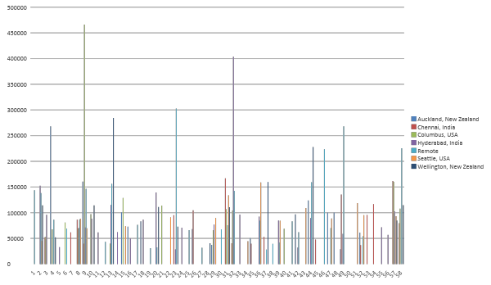
RESULTS
‹#›

Slide 12
Conclusion
The Employee Salary Analysis provides valuable insights into salary distribution, highlighting disparities and trends.
Key findings include notable differences in salaries across departments, work locations, and gender, as well as variations by employee type and tenure.
Key Takeaways :
Identify and Address Pay Gaps: Implement strategies to correct gender and location-based salary disparities.
Informed Decision-Making: Use data-driven insights to guide fair compensation practices and budgeting.
Strategic Enhancements: Leverage findings to improve employee satisfaction and retention through equitable salary adjustments.
Overall, the analysis supports strategic HR and financial planning, fostering a more transparent and fair compensation structure.

